Slide 1
The Economic Effects of Flood Buyout Programs
Prospectus Chapter by Emma Donnelly
4/23/2025

Slide 2
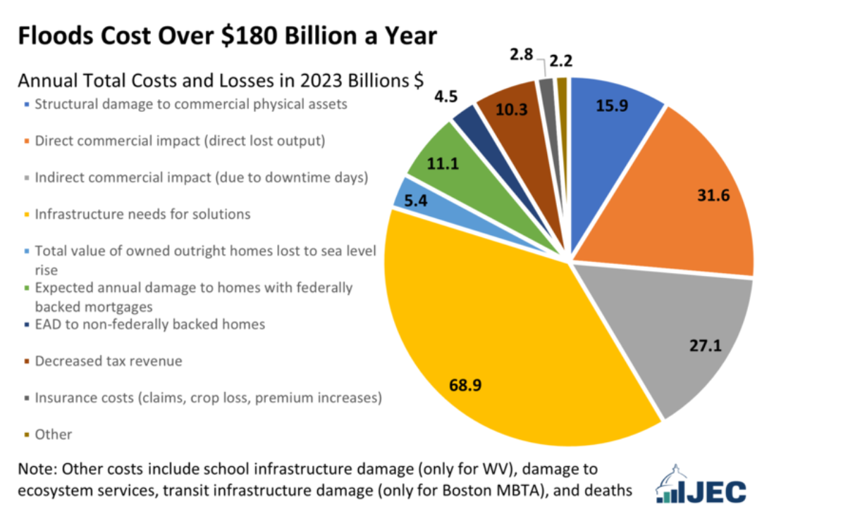
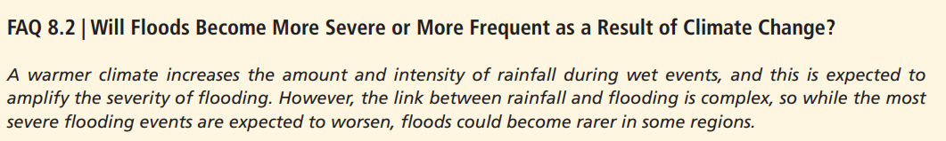
Motivation
Flooding is one of the most damaging and costly natural disasters, and is expected to increase with climate change.
Notes:
https://www.jec.senate.gov/public/index.cfm/democrats/2024/6/flooding-costs-the-u-s-between-179-8-and-496-0-billion-each-year#:~:text=The%20total%20annual%20economic%20burden,of%20U.S.%20GDP%20in%202023.
The Joint Economic Committee’s Democratic staff estimates that the total cost of flooding in the United States is between $179.8 and $496.0 billion each year in 2023 dollars, which is equivalent to 1-2% of U.S. GDP in 2023.
The IPCC projects that as global temperatures rise, the frequency and intensity of extreme weather events, including floods, will increase in many parts of the world. Specifically, warmer temperatures will lead to more intense rainfall and increased sea levels, contributing to more severe flooding events. While some regions may experience a decrease in the frequency of floods, the overall trend points to a more significant risk of flooding in many areas.

Slide 3
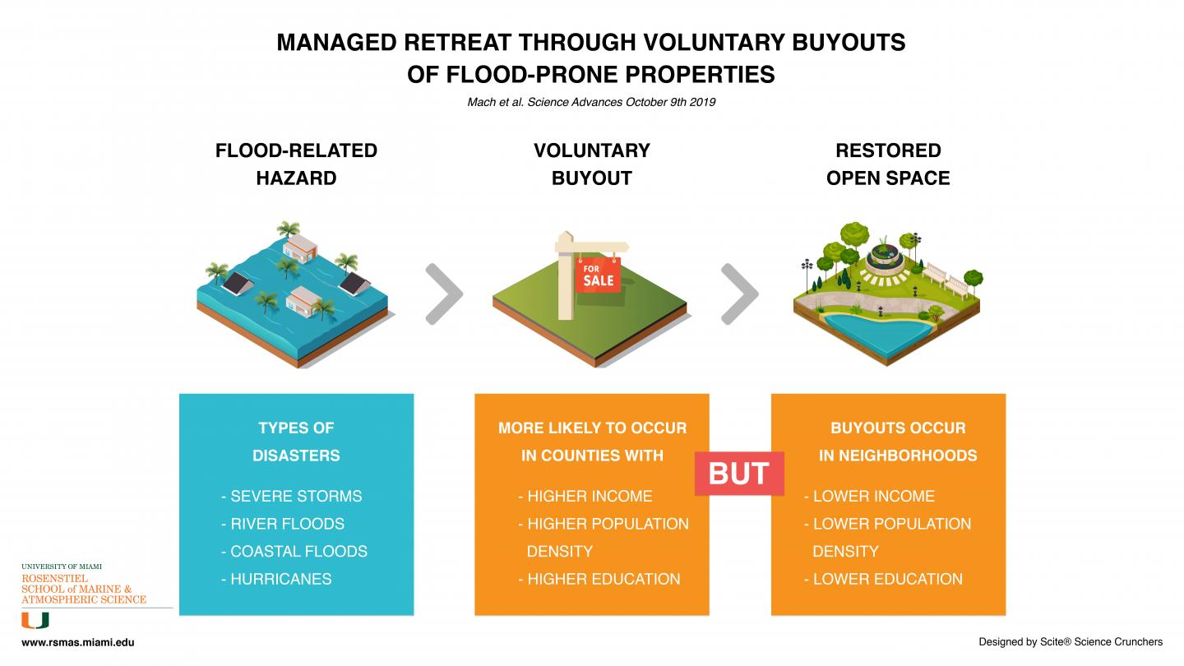
Motivation
Governments have turned to managed retreat as a strategy to reduce long-term damage.

Slide 4
Research Question & Hypothesis
Question: What are people willing to pay to avoid flood risk through participating in flood buyout programs? Is WTP different for different race/income groups?
Hypothesis: WTP to avoid flood risk is positive and significant. Yes, WTP is lower for minority race, lower income groups relative to base group.
Methodology: Residential Sorting Model

Slide 5
Contribution
First study to use a sorting model to estimate WTP to avoid flood risk through FBP.
Authors | Buyout program | Method | Value estimated | Spatial | Temporal | Race | Income
Guo et al., (2023) | Hurricane Sandy acquisition and buyout program | Hedonic (RP) | Property values, enhanced resilience, and job creation, | Yes | Yes | No | No
Nelson & Camp (2020) | Tennessee buyout | FEMA algorithm | Avoided structural damages plus relocation costs and volunteer labor, | No | No | No | No
Ando & Reeser (2022) | Hypothetical program | CVM (SP) | WTP for hypothetical pre-flood contract for post-flood buyout. | No | No | Yes | Yes
Jowers et al. (2023) | Various programs between 1989 and 2017 | Hedonic (RP) | Difference between FMV and buyout value for White, Black, and Hispanic owners, | No | No | Yes | No
Schoder (2024) | Various programs between 1989 and 2017 | Hedonic (RP) | Property value increase | No | No | Yes | Yes
Holloway, BenDor (2023) | Mecklenburg County, NC buyout program | Hedonic (RP) | Property value increase | Yes | Yes | No | No
Hashida & Dundas (2023) | New York Rising Buyout and Acquisition Program | Hedonic (RP) | Property values | Yes | Yes | No | No

Slide 6

Contribution
Why is a sorting model more appropriate than other models?
Capture Heterogeneity: Account for differences in household preferences, constraints, and choices.
Nonmarginal Policy Analysis: Better suited for estimating impacts of large or structural policy changes.
Equity Evaluation: Allow for analysis of distributional effects across diverse populations.
WTP Estimation: Provide more accurate estimates of willingness to pay by modeling endogenous amenities and feedback.
Notes:
If we have data on housing prices and attributes… why not just use a hedonic model??
Sorting models account for heterogeneous preferences among households.
HH sort into neighborhoods based on observed and unobserved factors
This reflects real-world behavior and helps avoid overestimation caused by OVB we see in hedonics.
Hedonic models:
Don’t include unobserved ➔ OVB➔ overstate true value of attribute
Sorting models:
Include location specific unobservables 𝜉ₜⱼ
Controls for correlation between unobservable amenities and prices using Ivs
2. Sorting models are better suited for estimating benefits from nonmarginal changes.
Hedonic models assume market conditions are fixed and don’t account for feedback loops and interactions.
This makes it challenging to use them to estimate the effects of large-scale policy changes that could cause people to relocate, prices to adjust, and amenities to change.
Sorting models account for how households’ preferences and choices interact with the broader economic landscape, including how policies affect housing prices, location choices, and amenities.
Sieg et al. (2004) show that while average MWTP estimates for marginal air quality changes in Los Angeles and Ventura are similar, estimated welfare gains from actual policy-induced ozone reductions differ by up to 800% once sorting and general equilibrium effects are included.
3. Sorting models allow researcher to disaggregate welfare estimates across different demographic or socioeconomic groups, which is crucial for evaluating the equity impacts of public policy.
How much different income groups are willing to pay for a change in environmental quality
How racial or ethnic sorting patterns respond to changes in public goods or neighborhood characteristics
How renters and owners experience different benefits (though many current models treat households as renters for simplicity)
4. Sorting models are better for estimating WTP.
Capitalization effects measure how much an amenity is reflected in housing prices after a policy change or shock.
Capitalization ≠ WTP (unless perfectly elastic demand, no sorting adjustments or endogenous amenities, no feedback effects)
A wedge arises between capitalization and WTP as households re-sort, preferences and incomes shift, and amenities adjust endogenously.
Sorting models account for these dynamics, so they produce more credible estimates of WTP than those based solely on capitalization from hedonic models.
These models estimate structural parameters of heterogeneity by using market equilibrium outcomes and agent behavior.
They go beyond partial equilibrium and marginal analysis to incorporate feedback loops and general equilibrium effects.
Examples include how pollution, congestion, and social opportunities change endogenously in response to sorting.

Slide 7

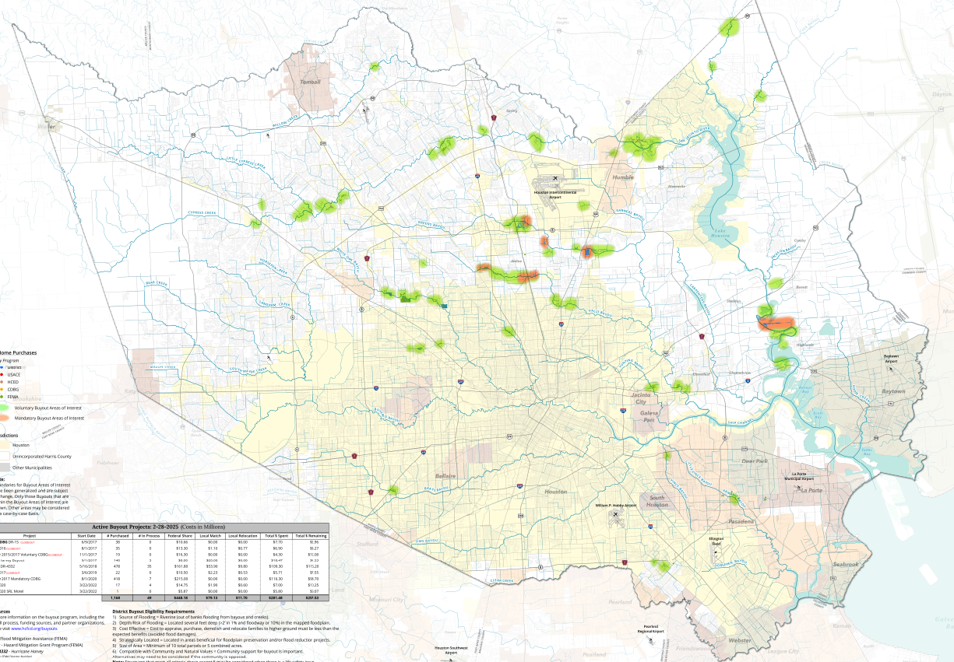
Setting
Notes:
4.7 million residents of Harris County, Texas
3rd most populous county in the US! Highest number of severe repetitive loss properties in the nation
Growing population and urban development
Racially, culturally, and economically diverse area
Lies in low coastal plains and includes a system of bayous
Voluntary Buyout Program started in 1985
Buyout criteria: (1) flood risk, (2) benefit–cost of acquiring the properties, (3) potential for acquired property to contribute to other HCFCD projects, (4) size of area for acquisition, and (5) owner and community support for buyouts (HCFCD 2020).

Slide 8
Data
Housing transactions for all sales in Harris County between [Year 1] and [Year 2]
Household structural characteristics
Flood buyout data from the Harris County Flood Control District
Binary indicator for whether the property was part of a flood buyout
Household demographic attributes from the Home Mortgage Disclosure Act (HMDA) database
Lang and VanCeylon (2025) match HMDA records to property transactions using sale year, loan amount, and Census tract.
Neighborhood characteristics
HCFCD shapefiles to link each property to localized flood risk indicators
Census block level demographics (race, income, tenure, and language), local crime rates, proximity to amenities (e.g., parks, libraries), and school quality measures
Distance to coast

Slide 9
Sorting Model
What is a sorting model?
Tiebout (1956) – Households "vote with their feet"
Utility = Amenities – Price
Location choice reveals preferences
Heterogeneous sorting → affects housing prices and supply of amenities
Notes:
Tiebout 1956): proposed that people "vote with their feet" by choosing communities that best match their preferences for public goods (like schools, parks, etc.).
People make choices about where they live (Tiebout 1956)
You decide where to live by weighing the utility from amenities of the house with the price of the house
Your choice of residence reveals information about your preferences for amenities
As heterogeneous HHs sort across the landscape, their collective location choices influence housing prices and supply of amenities

Slide 10
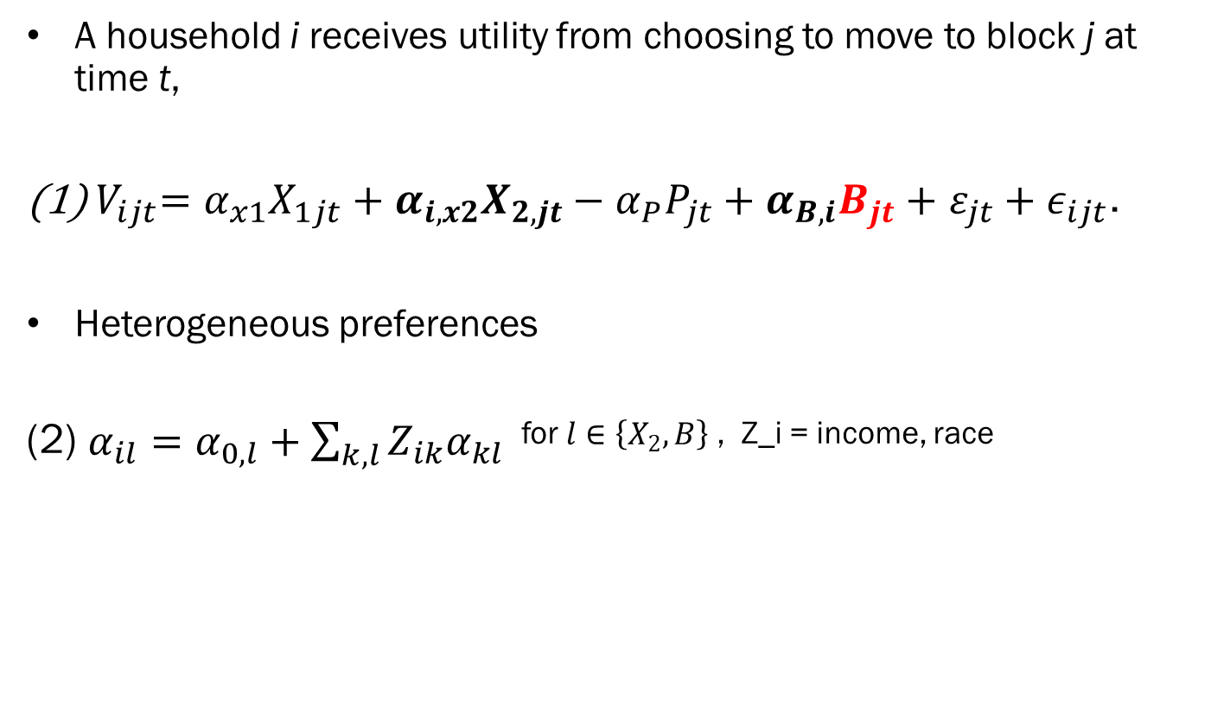
Sorting Model
A household i receives utility from choosing to move to block j at time t,
${ V}_{ijt}=α_{x1}X_{1jt}+α_{i,x2}X_{2,jt}−$ $α_{P}P_{jt}+α_{B,i}B_{jt}+$ $ε_{jt}+ε_{ijt}$.
Heterogeneous preferences
(2) $α_{il}=α_{0,l}+\sum_{k,l}{{Z_{ik}α}_{kl}}$ for $l∈\left\{X_{2}, B\right\}$ , Z_i = income, race
Notes:
Choice of census block jjj at time ttt depends on:
X1jtX_1jtX1​jt: Block-level attributes with homogeneous preferences (e.g., housing structure, flood risk).
X2jtX_2jtX2​jt: Block-level attributes with heterogeneous preferences (e.g., income, race, population density).
BijtB_{ijt}Bijt​: Indicator for whether household i’s location choice is associated with a buyout property (captures flood risk reduction preference).
PjtP_{jt}Pjt​: Price of housing in block j at time t.
ϵijt\epsilon_{ijt}ϵijt​: Idiosyncratic shock to household i’s utility for block j.
"This is the utility function. Households weigh neighborhood characteristics, housing prices, and whether a location is associated with a buyout."
"Preferences over certain characteristics like buyouts or neighborhood demographics vary by household traits."

Slide 11
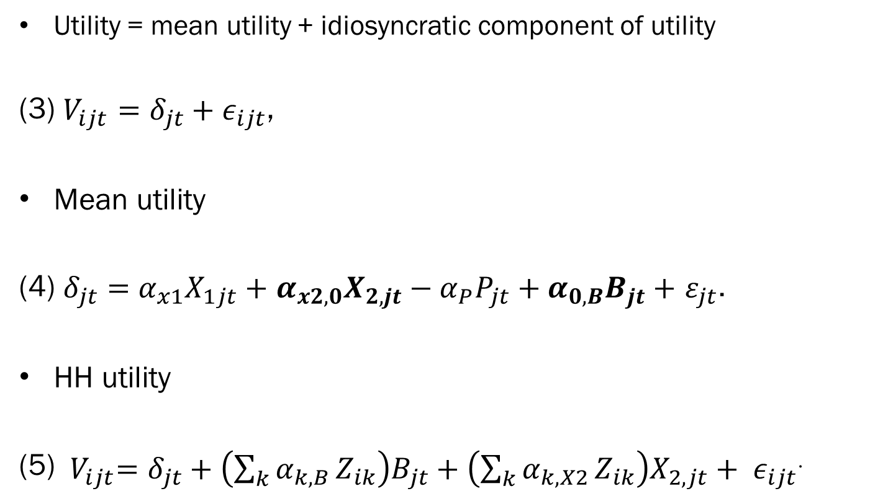
Sorting Model
Utility = mean utility + idiosyncratic component of utility
(3) $V_{ijt}=δ_{jt}+ε_{ijt}$,
Mean utility
(4) $δ_{jt}=$ $α_{x1}X_{1jt}+$ $α_{x2,0}X_{2,jt}−α_{P}P_{jt}+α_{0,B}B_{jt}+$ $ε_{jt}$.
HH utility
(5) ${ V}_{ijt}=δ_{jt}+\left(\sum_{k}{α_{k,B}}Z_{ik}\right)B_{jt}+\left(\sum_{k}{α_{k,X2}}Z_{ik}\right)X_{2,jt}+ ε_{ijt}$.
Notes:
Choice of census block jjj at time ttt depends on:
X1jtX_1jtX1​jt: Block-level attributes with homogeneous preferences (e.g., housing structure, flood risk).
X2jtX_2jtX2​jt: Block-level attributes with heterogeneous preferences (e.g., income, race, population density).
BijtB_{ijt}Bijt​: Indicator for whether household i’s location choice is associated with a buyout property (captures flood risk reduction preference).
PjtP_{jt}Pjt​: Price of housing in block j at time t.
ϵijt\epsilon_{ijt}ϵijt​: Idiosyncratic shock to household i’s utility for block j.
"Utility is split into a mean utility shared by all households and a random component unique to each hous
"This formulation helps identify how much different groups value things like buyouts or local demographics."ehold."

Slide 12
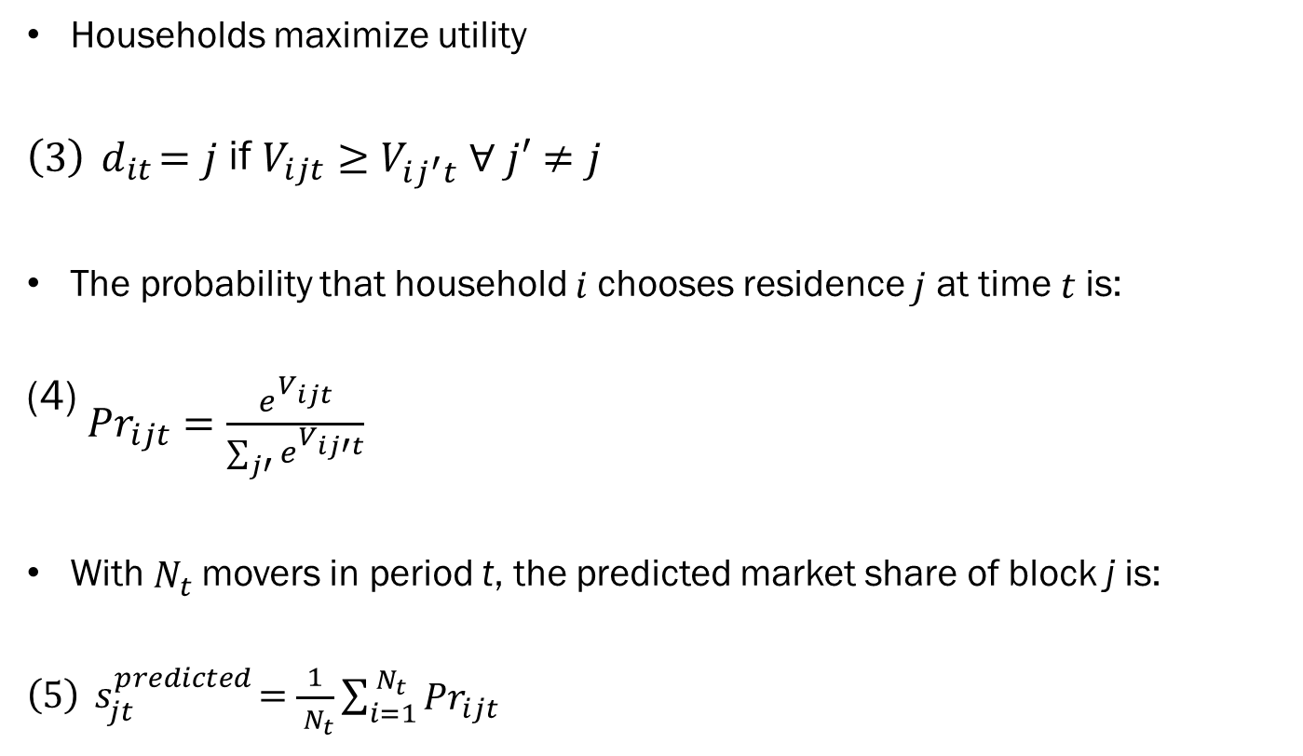
Sorting Model
Households maximize utility
$\left(3\right){ d}_{it}=j$ if $V_{ijt}≥$ $V_{ij^{′}t} ∀ j′≠j$
The probability that household 𝑖 chooses residence 𝑗 at time 𝑡 is:
(4) ${Pr}_{ijt}=\frac{e^{V_{ijt}}}{\sum_{j′}{e^{V_{ij′t}}}}$
With${ N}_{t}$movers in period t, the predicted market share of block j is:
$\left(5\right){ s}_{jt}^{predicted}=$ $\frac{1}{{ N}_{t}}\sum_{i=1}^{{ N}_{t}}{{Pr}_{ijt}}$
Notes:
"Households choose the block that maximizes their utility. We predict choice probabilities and match them to observed mover shares."

Slide 13
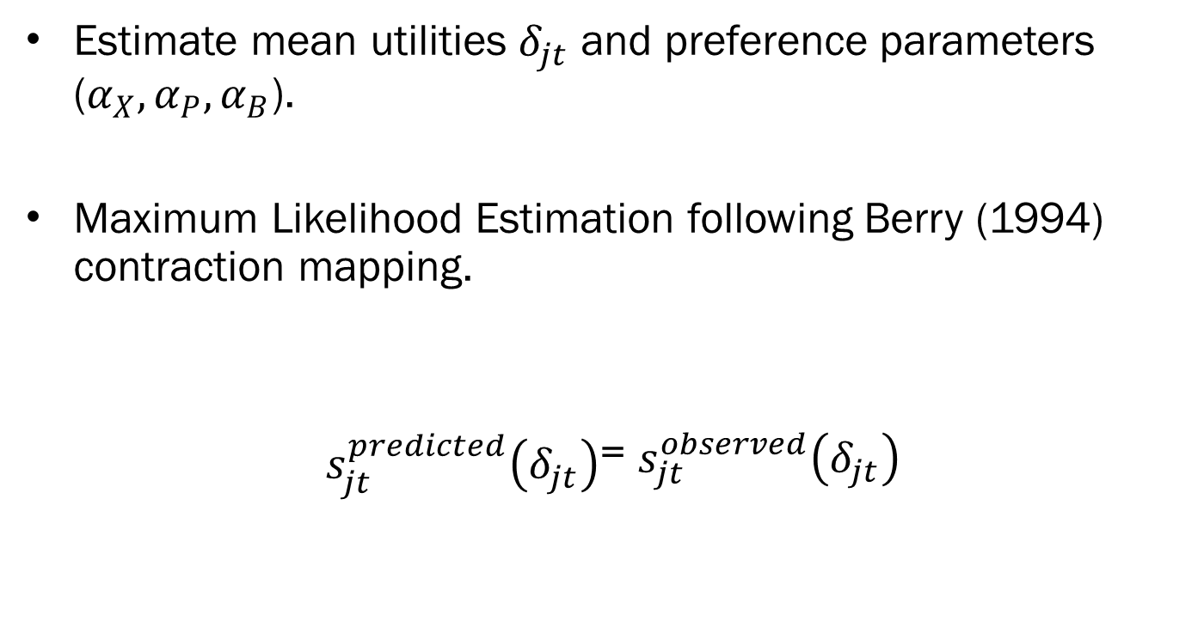
Estimation
Stage 1
Estimate mean utilities $δ_{jt}$ and preference parameters ($α_{X}, α_{P}, α_{B}$).
Maximum Likelihood Estimation following Berry (1994) contraction mapping.
$s_{jt}^{predicted}\left(δ_{jt}\right)$= $s_{jt}^{observed}\left(δ_{jt}\right)$
Notes:
"Stage 1 estimates the utilities and preference weights by matching observed and predicted choices using contraction mapping."

Slide 14
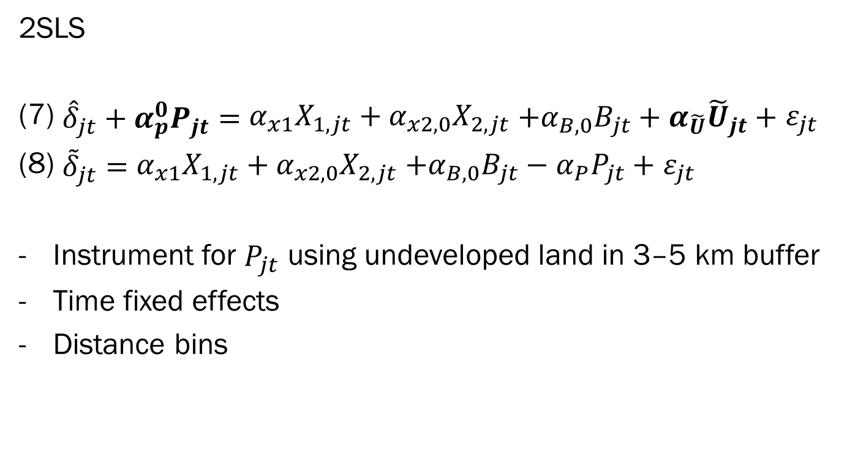
Estimation
Stage 2
2SLS
(7) ${\hat{δ}}_{jt}+α_{p}^{0}P_{jt}=$ $α_{x1}X_{1,jt}+α_{x2,0}X_{2,jt}$ $+α_{B,0}B_{jt}+α_{\tilde{U}}{\tilde{U}}_{jt}+$ $ε_{jt}$
(8) ${\tilde{δ}}_{jt}=$ $α_{x1}X_{1,jt}+α_{x2,0}X_{2,jt}$ $+α_{B,0}B_{jt}−{α_{P}P}_{jt}+$ $ε_{jt}$
Instrument for $P_{jt}$ using undeveloped land in 3–5 km buffer
Time fixed effects
Distance bins
Notes:
To address the endogeneity of price (i.e., unobserved quality may affect both utility and price), we instrument for $P_{jt}$
"Stage 2 recovers the base group’s preferences. I instrument for prices to address price endogeneity using nearby land characteristics.“
Time fixed effects to control for unobserved spatial and temporal shocks
Distance bins for correlation with coastal amenities
We use undeveloped land within a 3- to 5-kilometer buffer of a neighborhood as our instrument for the price variable.
So, in Equation 7, we regress the mean utility (which represents the value of living in a neighborhood) on neighborhood attributes, but we adjust the price by including the instrument, which is the share of undeveloped land nearby."
Now, moving on to the second stage. Once we have the fitted values for price from the first stage, we use them to adjust the mean utility of a neighborhood. This allows us to estimate the preference for various neighborhood attributes without the bias caused by endogeneity.
In Equation 8, we adjust the mean utility using the new price values. This means we're correcting for the endogeneity in price and getting more accurate estimates of the preferences for different attributes—like house size, flood risk, and distance to amenities."
Additional Considerations: "Additionally, we include time fixed effects to account for macroeconomic trends that could affect all neighborhoods over time, and we also group neighborhoods into distance bins. This helps control for local factors, like flood risk or coastal access, which could also influence utility."
Conclusion: "In summary, this two-stage process allows us to estimate neighborhood preferences more accurately by addressing the endogeneity of price through the use of instrumental variables, and by controlling for other neighborhood-specific and time-related factors."
S

Slide 15
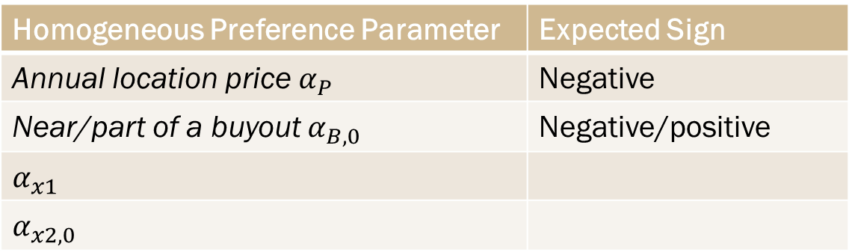
Expected Results
Stage 2: Homogeneous parameter estimates
Homogeneous Preference Parameter | Expected Sign
Annual location price $α_{P}$ | Negative
Near/part of a buyout $α_{B,0}$ | Negative/positive
$$α_{x1}$$
$$α_{x2,0}$$

Slide 16
Expected Results
Stage 1: Heterogeneous parameter estimates
Heterogeneous Preference Parameter | Expected Sign
Base Group
White/Asian, Income quintile 1 | Positive
Relative to Base Group
x Black | Negative
x Hispanic | Negative
x Income quintile 2 | Positive
x Income quintile 3 | …
x Income quintile 4 | …
x Income quintile 5 | Positve

Slide 17
Thank You!
donnel26@purdue.edu

Slide 18
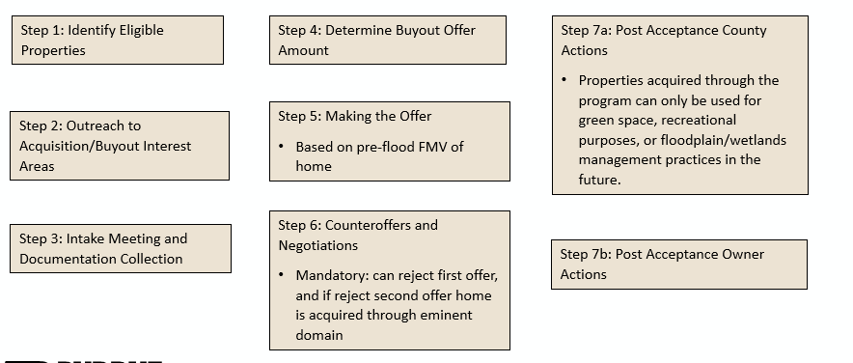

Slide 19
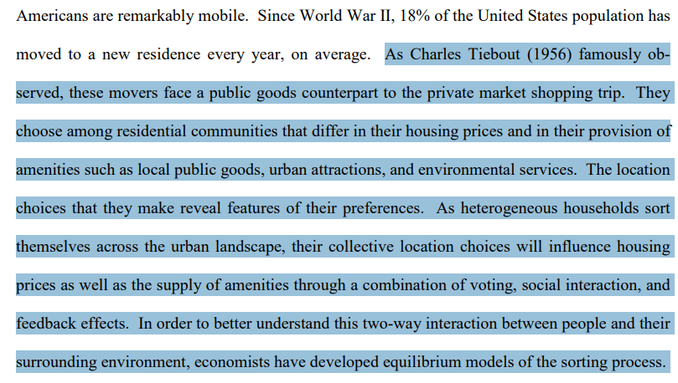
Contribution
From the book chapter Equilibrium Sorting Models of Land Use and Residential Choice by H. Allen Klaiber, Nicolai V. Kuminoff

Slide 20
Contribution
Why is a sorting model more appropriate than other models?
Brief history of residential sorting models
Tiebout (1956): proposed that people "vote with their feet" by choosing communities that best match their preferences for public goods (like schools, parks, etc.).
1960s-1970s: Urban economics papers focused on how housing prices vary with distance to jobs, using aggregated data.
1970s-1990s: Discrete Choice & Random Utility Models
2000s-Today: Bayer, McMillan, and Rueben (2004)
Notes:
A residential sorting model is a framework used in economics to understand how individuals or households choose where to live, based on the characteristics of locations and their own preferences. These models assume that people "sort" themselves into neighborhoods or jurisdictions by weighing trade-offs across housing prices, school quality, environmental amenities, demographics, and other features. Formally, these are usually modeled using random utility models (RUMs), where a household chooses the location that provides the highest utility, given its preferences and constraints. Sorting models can capture heterogeneous preferences—meaning different households may value the same amenity differently—and can account for equilibrium effects, such as how household decisions shape neighborhood composition or property prices.
The roots of sorting models trace back to Charles Tiebout’s 1956 paper, which proposed that people “vote with their feet” by moving to communities that offer the mix of taxes and public goods they prefer. This was a theoretical breakthrough, suggesting that decentralized choice could lead to efficient allocation of public services. However, it assumed away many real-world complexities like moving costs, housing markets, and imperfect information. During the 1960s and 70s, urban economists like Alonso, Muth, and Mills advanced spatial models that explained how housing prices and population densities varied with distance from city centers, but these models generally assumed a representative agent rather than modeling sorting behavior among diverse households.
A major methodological advance came with the development of discrete choice models—especially through McFadden’s work on random utility theory—which allowed economists to model choices among a set of alternatives using probabilistic frameworks. These models were first applied to housing in the 1970s and 80s, but were often limited by data availability and computational constraints. It wasn’t until the 2000s that researchers were able to estimate large-scale residential sorting models using rich microdata and improved computational techniques. A foundational paper in this area is Bayer, McMillan, and Rueben (2004), which modeled households choosing among thousands of neighborhoods in the San Francisco Bay Area. Their model incorporated heterogeneous preferences (e.g., by income or race) and allowed neighborhood composition to be endogenous, meaning people’s location choices affect, and are affected by, who else lives there.
Modern sorting models are now widely used to evaluate policy. For example, they can estimate how much people are willing to pay for better schools, safer neighborhoods, or cleaner air, and how these valuations vary across households. Crucially, they allow researchers to correct for endogeneity—for example, the fact that better schools may attract wealthier families—by using equilibrium modeling and instruments. They are also used to simulate counterfactual scenarios, such as how new zoning laws or flood zone designations might change where people choose to live, and what that implies for segregation, inequality, and welfare.
Sorting models bridge the gap between theory and empirics, combining microeconomic foundations (utility maximization) with rich datasets and structural econometrics. They are central to modern urban, public, and environmental economics. As the literature has evolved, researchers have developed hybrid models that connect sorting behavior with hedonic pricing models, leading to a more unified framework for valuing amenities and evaluating policy.

Slide 21
Contribution
Why is a sorting model more appropriate than other models?
What is a sorting model?
The first step of a sorting model is to describe the landscape and structure of household preferences
A household chooses the residence that maximizes their utility out of a set of alternative residences. Utility is a function of observable household characteristics, houses, and communities.
A

Slide 22
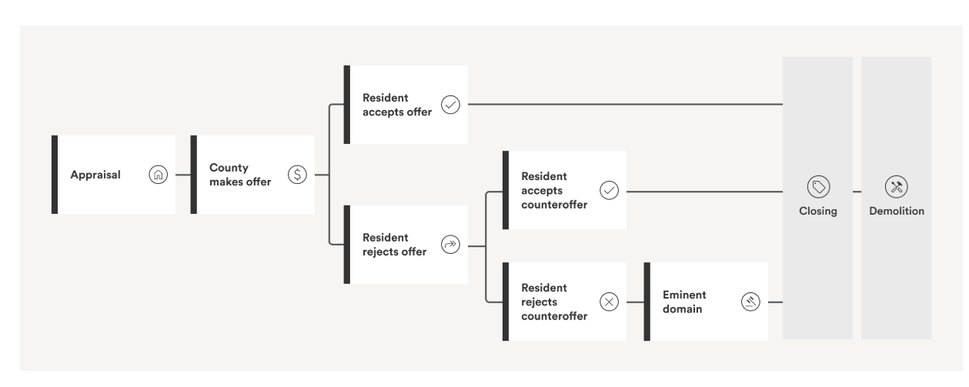
Setting
Harris County Voluntary and Mandatory Flood Buyout Program
Project Recovery (Mandatory) Buyout Program started in 2020 in response to 2017 Hurricane Harvey

Slide 23
Contribution
Why is a sorting model more appropriate than other models?
2. Sorting models are better suited for estimating benefits from nonmarginal changes.
Hedonic models assume market conditions are fixed and don’t account for feedback loops and interactions.
This makes it challenging to use them to estimate the effects of large-scale policy changes that could cause people to relocate, prices to adjust, and amenities to change.
Sorting models account for how households’ preferences and choices interact with the broader economic landscape, including how policies affect housing prices, location choices, and amenities.
Sieg et al. (2004) show that while average MWTP estimates for marginal air quality changes in Los Angeles and Ventura are similar, estimated welfare gains from actual policy-induced ozone reductions differ by up to 800% once sorting and general equilibrium effects are included.

Slide 24
Contribution
Why is a sorting model more appropriate than other models?
3. Sorting models allow researcher to disaggregate welfare estimates across different demographic or socioeconomic groups, which is crucial for evaluating the equity impacts of public policy.
How much different income groups are willing to pay for a change in environmental quality
How racial or ethnic sorting patterns respond to changes in public goods or neighborhood characteristics
How renters and owners experience different benefits (though many current models treat households as renters for simplicity)

Slide 25
Contribution
Why is a sorting model more appropriate than other models?
4. Sorting models are better for estimating WTP.
Capitalization effects measure how much an amenity is reflected in housing prices after a policy change or shock.
Capitalization ≠ WTP (unless perfectly elastic demand, no sorting adjustments or endogenous amenities, no feedback effects)
A wedge arises between capitalization and WTP as households re-sort, preferences and incomes shift, and amenities adjust endogenously.
Sorting models account for these dynamics, so they produce more credible estimates of WTP than those based solely on capitalization from hedonic models.

Slide 26
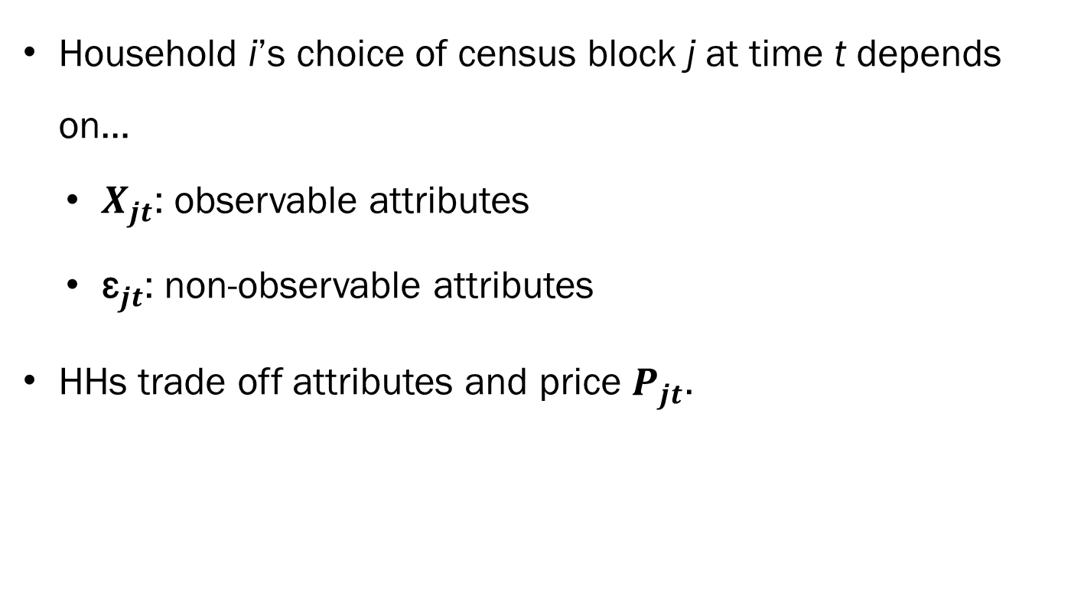
Sorting Model
Household i’s choice of census block j at time t depends on…
$X_{jt}$: observable attributes
${\text{ε}}_{jt}$: non-observable attributes
HHs trade off attributes and price $P_{jt}$.
Notes:
Choice of census block j at time t depends on…
$X_{jt}$: observable residence attributes (house structure variables, spatial amenities, distance to coast, flood risk, neighborhood sociodemographics)
${\text{ε}}_{jt}$: non-observable block attributes
HHs trade off attributes and price $P_{jt}$.

Slide 27
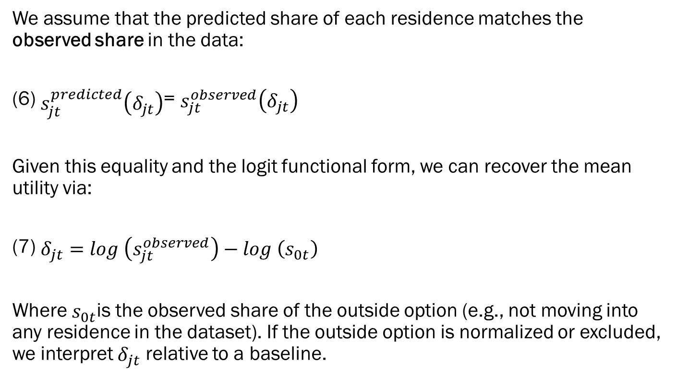
Estimation
Stage 1
We assume that the predicted share of each residence matches the observed share in the data:
(6) $s_{jt}^{predicted}\left(δ_{jt}\right)$= $s_{jt}^{observed}\left(δ_{jt}\right)$
Given this equality and the logit functional form, we can recover the mean utility via:
(7) $δ_{jt}=log \left(s_{jt}^{observed}\right)−log \left(s_{0t}\right)$
Where $s_{0t}$is the observed share of the outside option (e.g., not moving into any residence in the dataset). If the outside option is normalized or excluded, we interpret $δ_{jt}$ relative to a baseline.

Slide 28
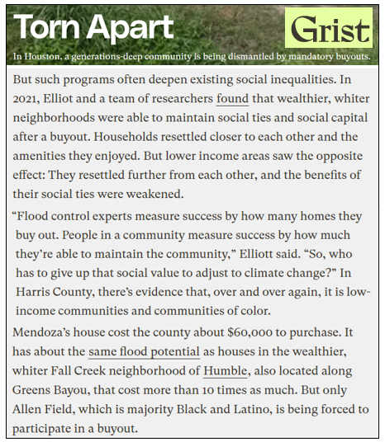
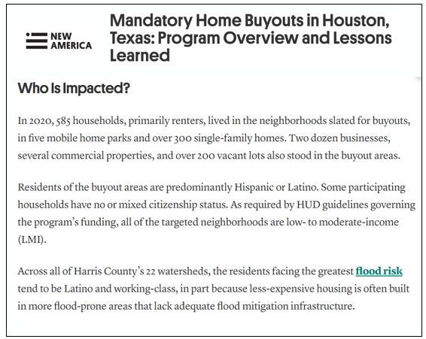
Setting

